Slide 1
Java arendaja õhtuõpe

Slide 2
Ülesanded (vanad)
BankController
EmployeeController

Slide 3
Install PostgreSql

Slide 4
Database design
Data is stored in tables
Tables store data with specified structure
You can define relations betwen databases
Normalization

Slide 5
Users
User
id | first_name | last_name | role
1 | Mari | Maasikas | Administrator
2 | Kristo | Kaalikas | User
3 | Lembit | Liblikas | User
4 | Märt | Maadleja | Editor
5 | Ene | Eskimo | Moderator

Slide 6
Users with many roles
User
id | first_name | last_name | role
1 | Mari | Maasikas | Administrator
2 | Kristo | Kaalikas | User
3 | Lembit | Liblikas | User
4 | Märt | Maadleja | Editor, Moderator
5 | Ene | Eskimo | Moderator

Slide 7
Multiple tables
User
id | first_name | last_name | username | email
1 | Mari | Maasikas | mari.maasikas | mari.maasikas@gmail.com
2 | Kristo | Kaalikas | kristo.kaalikas | kristo.kaalikas@gmail.com
3 | Lembit | Liblikas | lembit.liblikas | lemps123@mail.ee
4 | Märt | Maadleja | mart.maadleja | mart@autoremont.ee
5 | Ene | Eskimo | ene.eskimo | ene.eskomo3@yahoo.com
Role
id | name
1 | Administrator
2 | Moderator
3 | Editor
4 | User

Slide 8
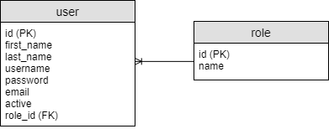
One to many relation
User
id | first_name | last_name | username | email | role_id
1 | Mari | Maasikas | mari.maasikas | mari.maasikas@gmail.com | 1
2 | Kristo | Kaalikas | kristo.kaalikas | kristo.kaalikas@gmail.com | 4
3 | Lembit | Liblikas | lembit.liblikas | lemps123@mail.ee | 4
4 | Märt | Maadleja | mart.maadleja | mart@autoremont.ee | 3
5 | Ene | Eskimo | ene.eskimo | ene.eskomo3@yahoo.com | 2
Role
id | name
1 | Administrator
2 | Moderator
3 | Editor
4 | User

Slide 9
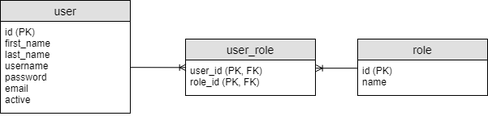
Many to many relation
User
id | first_name | last_name | username | email
1 | Mari | Maasikas | mari.maasikas | mari.maasikas@gmail.com
2 | Kristo | Kaalikas | kristo.kaalikas | kristo.kaalikas@gmail.com
3 | Lembit | Liblikas | lembit.liblikas | lemps123@mail.ee
4 | Märt | Maadleja | mart.maadleja | mart@autoremont.ee
5 | Ene | Eskimo | ene.eskimo | ene.eskomo3@yahoo.com
Role
id | name
1 | Administrator
2 | Moderator
3 | Editor
4 | User
User Role
user_id | role_id
1 | 1
2 | 4
3 | 4
4 | 3
5 | 2
4 | 2

Slide 10
Create bank dabase schema
Customers
Accounts
Transaction History

Slide 11
SQL - INSERT
INSERT INTO table_name (column1, column2) VALUES (‘value1’, ‘value2’);

Slide 12
SQL - SELECT
SELECT * FROM table_name;
SELECT column1, column2 FROM table_name;
SELECT * FROM table_name where column_name = ‘column_value’;

Slide 13
SQL - UPDATE
UPDATE table_name SET column_name = ‘column_value’ WHERE id = 5;

Slide 14
SQL - DELETE
DELETE table_name WHERE id = 5;

Slide 15
Add maven dependency
<dependency>
<groupId>org.springframework.boot</groupId>
<artifactId>spring-boot-starter-jdbc</artifactId>
</dependency>

Slide 16
application.properties
spring.datasource.url=jdbc:postgresql://localhost/db_name spring.datasource.username=postgres spring.datasource.password=docker spring.datasource.driver-class-name=org.postgresql.Driver

